Slide 1

Predicting the Performance Evolution of Facebook Posts
Mihir Gandhi
Rini Joshi
Spoorthi Gunuganti
Trisha Chandra
Notes:
Good morning everyone, today we are presenting on the prediction of performance evolution of Facebook posts through various metrics
Lets first begin my introducing the team

Slide 2

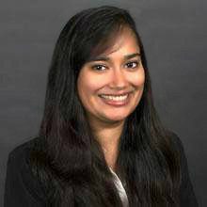
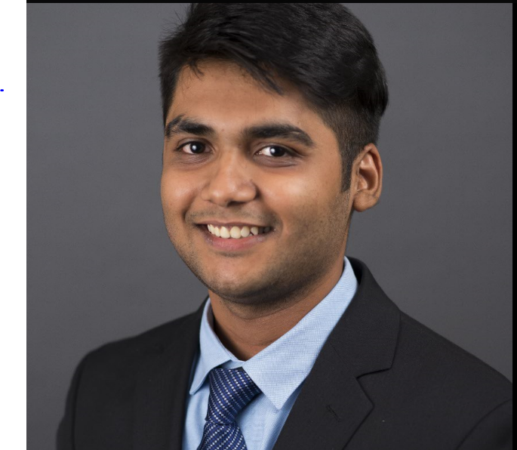


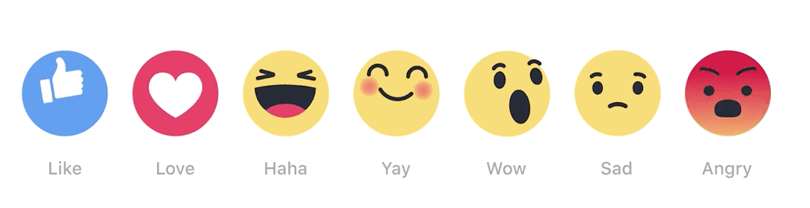
What is
The Team
Rini Joshi
Mihir Gandhi
Spoorthi
Trisha Chandra

Slide 3
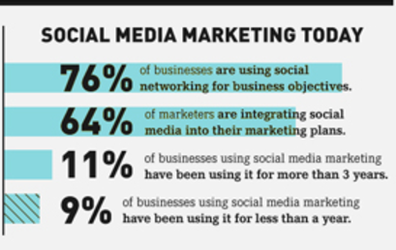

What is
What’s in a Post?
Social media is on its way to become the most important channel for brand recognition.
85% of marketers using social media unsure of the social media tool to use!? How to use!? When to use!?
Goal: Predicting impact of facebook posts based on the their characteristics
To post or not to post!
Notes:
So to start off
We all know the impact of social media in our lives and on our opinions. Social networking sites are on its way to become the most important channel for brand recognition.
According to one report by Social Media Examiner, 85 percent of marketers who use social media aren’t clear on which social media tools would work best for their business.
Our analysis is to help these social media managers decide on the ideal medium and time that would lead to maximum impact.

Slide 4
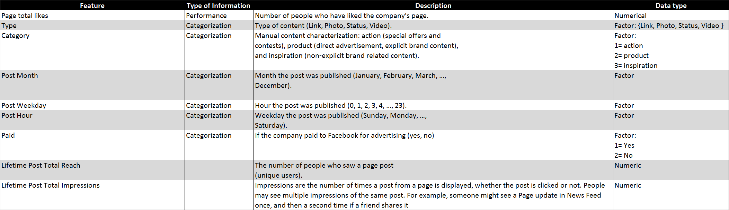
What is
Dataset Description
Notes:
To get you acquainted with our data set:
First the 7 independent variables that influence the performance of the post
Type, category, post month hour weekday paid or not and total page likes.

Slide 5
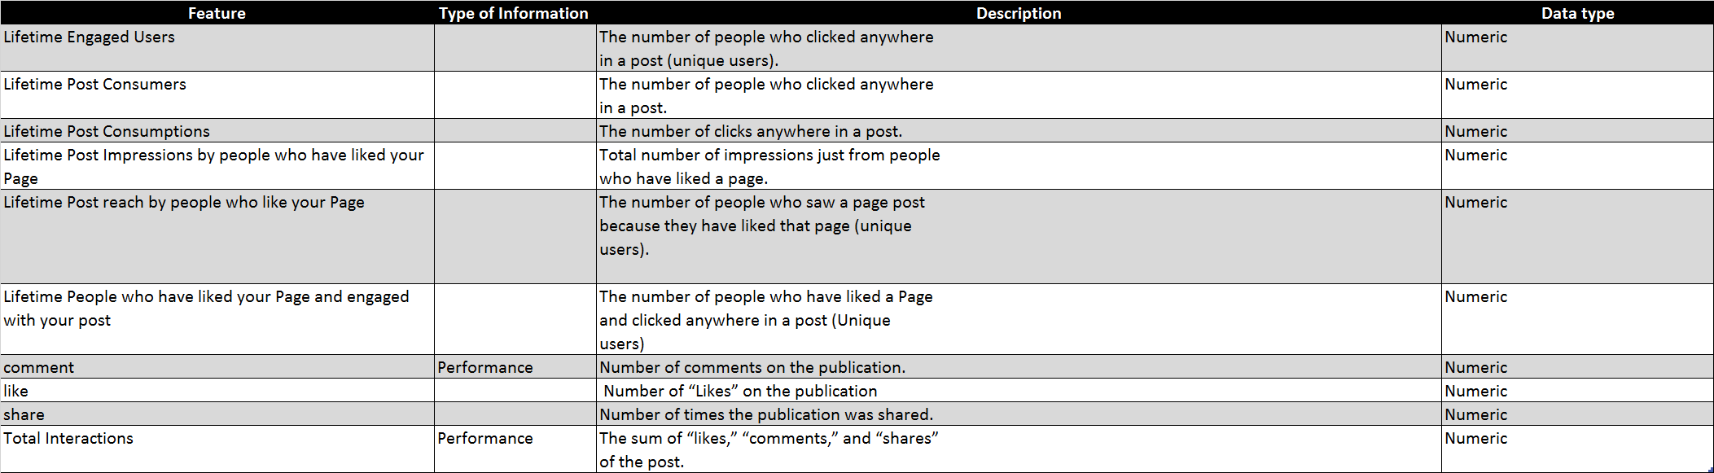
What is
Dataset Description
Notes:
As for dependent variables, we have 12 of them.
Divided into impressions and engagements.
Impressions are those that are displayed on the homepage of the user.
And engagements are variables that define actual user interaction feedback; such as comments, likes shares, etc

Slide 6
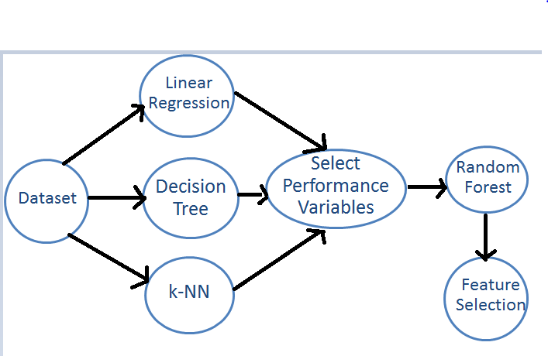
What is
Structure
For selecting relevant dependent variables:
Linear Regression
Decision Tree
k-NN
Notes:
Our agenda for today is first implement linear regression, decision tree and KNN ALGORITHMS; USE RMSE AND INHERENT BUSINESS KNOWLEDGE TO SELECT THE MOST IMPORTANT PERFORMANCE VARIABLES
AND THEN IMPLEMENTED RANDOM FOREST TO UNDERSTAND THE IMPACT OF EACH FEATURE ON THE OUTPUT ACCURACY.

Slide 7
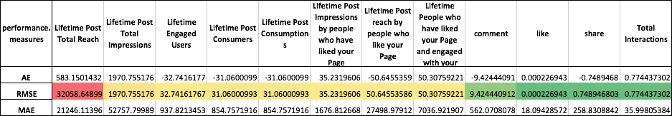
What is
Algorithms Implemented
Linear Regression:

Slide 8
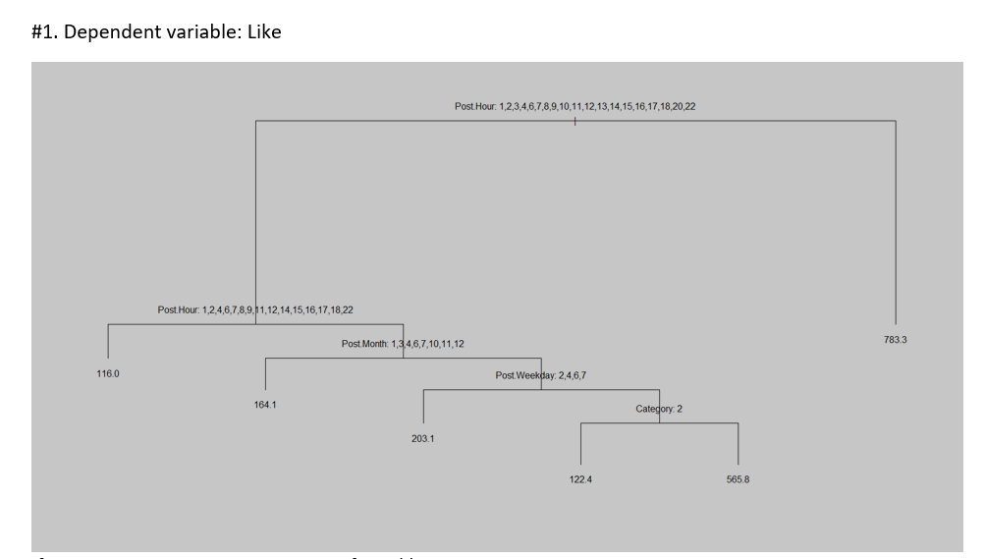
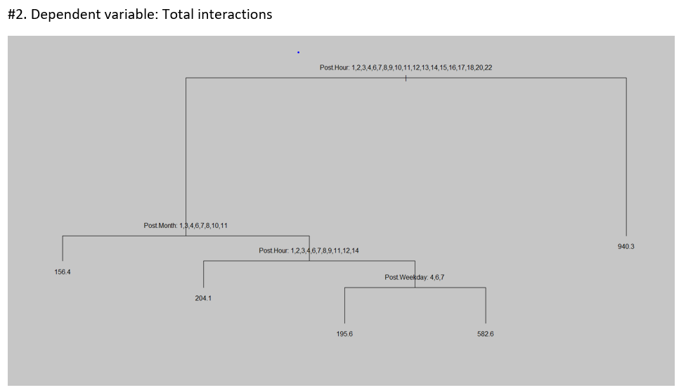
What is
Algorithms Implemented
2. Decision Tree:
Conclusion: Best Post Hours - 5,19,21,23; Best Post Month- Feb, May, Aug, Sept Best Weekday: Sun, Tue, Wed, Fri

Slide 9
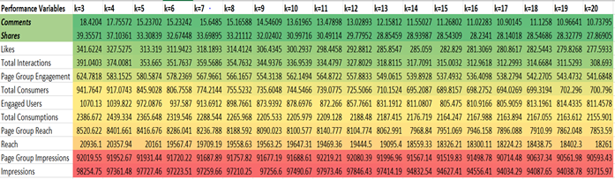
What is
Algorithms Implemented
3. k-NN (RMSE for each performance variable):

Slide 10
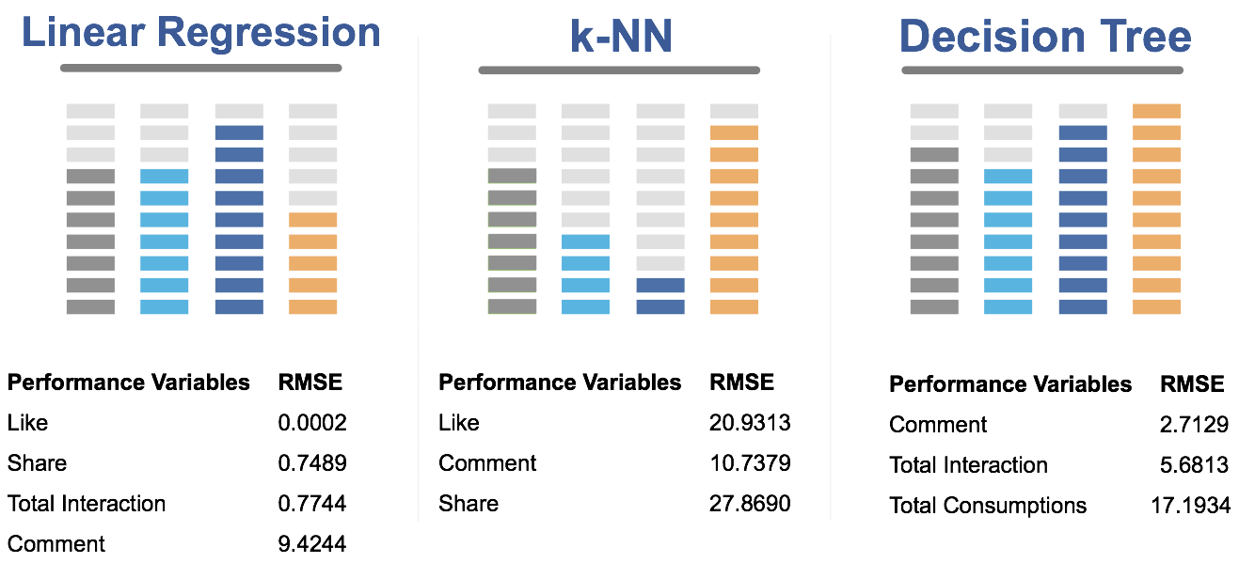
What is
Performance Evaluation

Slide 11

What is
What defines most the engagement?
The number of comments, likes and shares; intuitively grouped under Total Interactions are engagements that define explicit user actions on the post.
They came out as a stronger measure of user feedback compared to impressions.
As evidenced from the performance metric data of all the algorithms, the RMSE (Root Mean Square Deviation) is comparatively less for (comments, likes and shares, Total Interactions) these features.

Slide 12
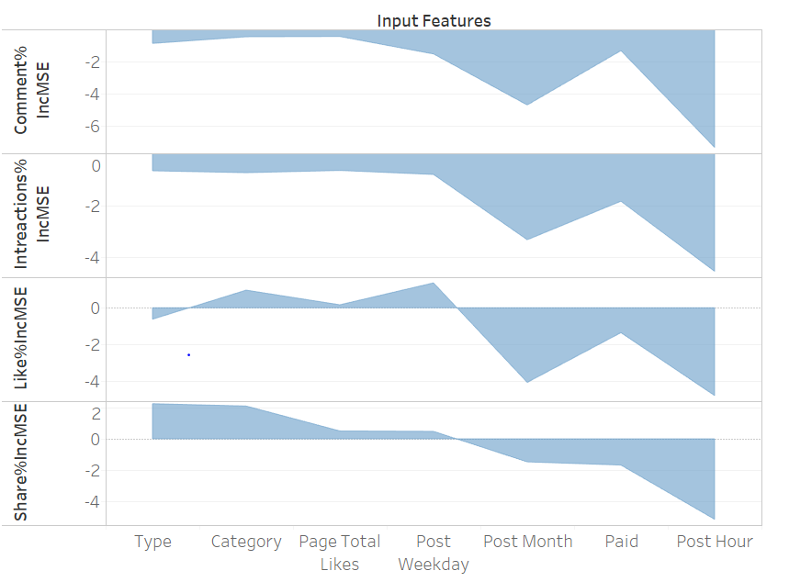
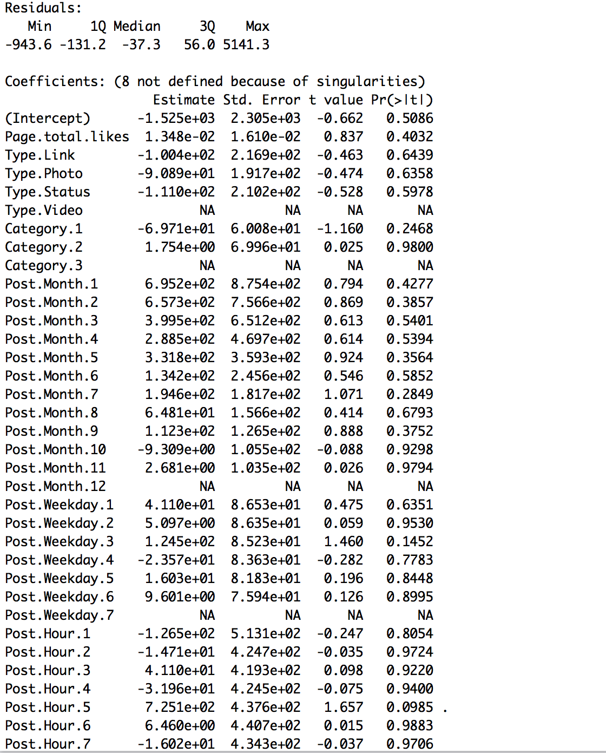
What is
Feature Impact (Total Interactions)
Random Forest
Random Forest
Linear Regression

Slide 13
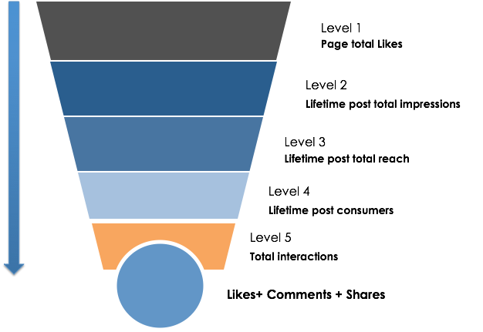
What is
Business Conversion Funnel

Slide 14
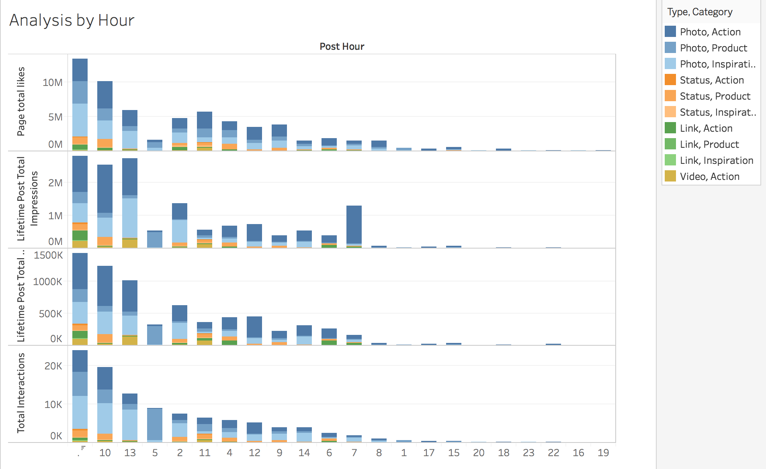
What is
Business Insights

Slide 15
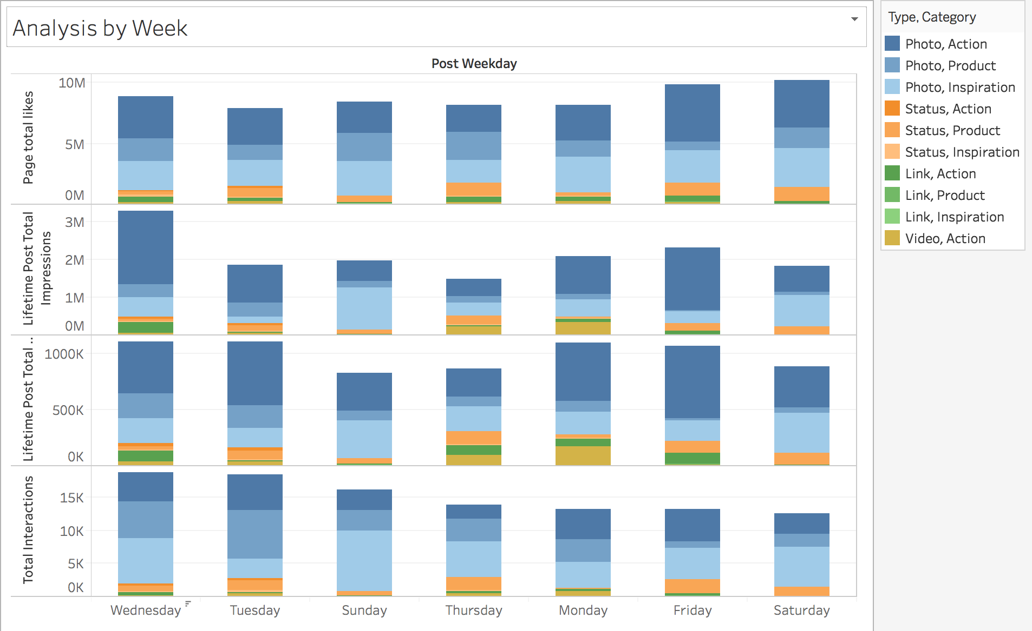
What is
Business Insights

Slide 16
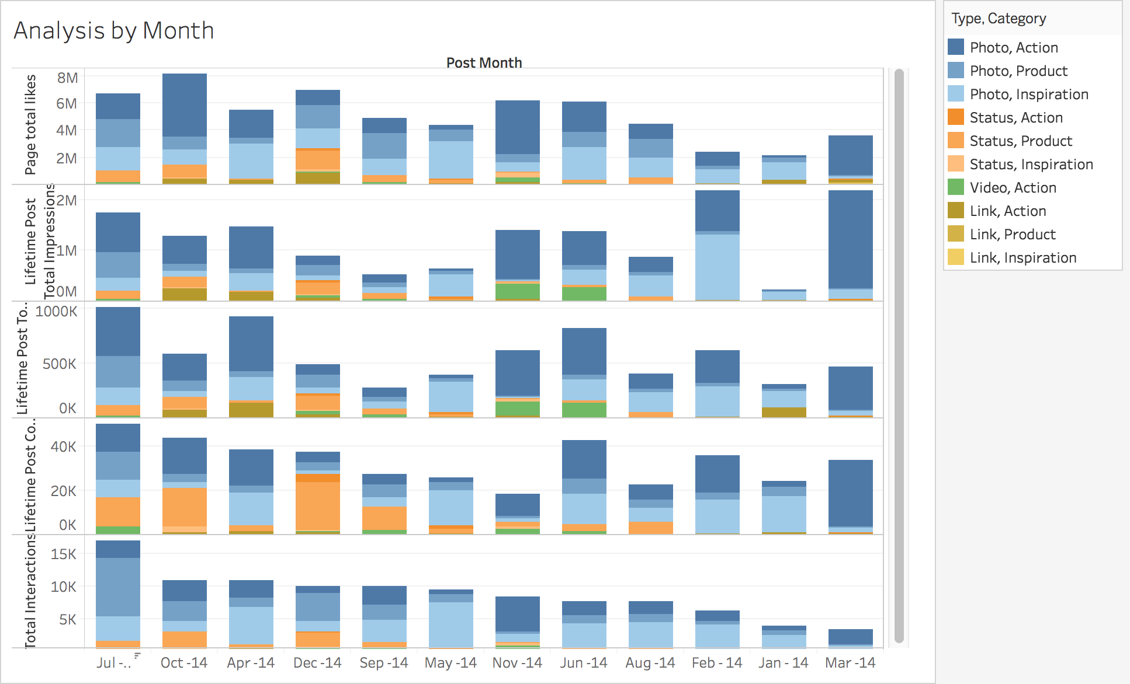
What is
Business Insights

Slide 17
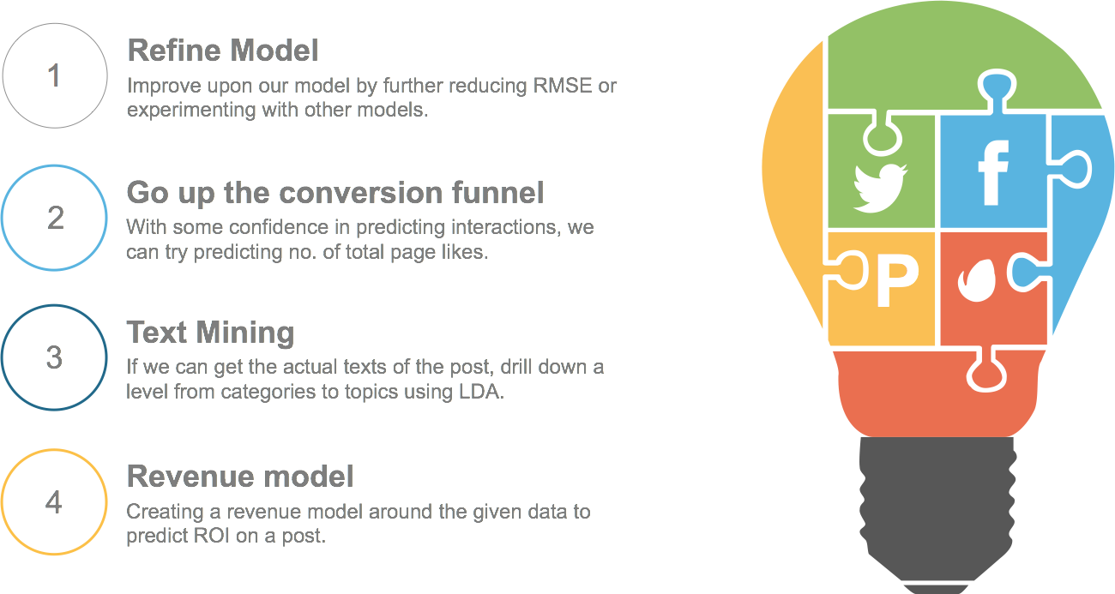
What is
What’s next?

Slide 18

What is
Q&A
Direct your questions at our Facebook Page: Team@21
Notes:
Dataset source: http://archive.ics.uci.edu/ml/datasets/Facebook+metrics#
Reference: http://econpapers.repec.org/article/eeejbrese/v_3a69_3ay_3a2016_3ai_3a9_3ap_3a3341-3351.htm

